Slide 1

Vehicle Detection and Monitoring using Magnetic Field Sensors
Pradeep Kumar. N (1BG10EC058)
Nikunj. T (1BG10EC054)
Nafeeya Samar (1BG10EC047)
Noor Zahara (1BG10EC055)
Project Guide:
Anuradha V. Rao

Slide 2

Vehicle Detection and Monitoring using Magnetic Field Sensors
Motivation:
Alleviation of traffic congestion by improving the efficiency of the current transportation system.
Solution: Real-time traffic surveillance
Requirement: Acquisition of traffic metrics (speed, volume etc.) which can be obtained using Magnetic sensors and Induction loops.
Objectives:
Development of traffic monitoring system using low power, low cost magnetic sensors and induction loops.
The data acquired is used to increase the efficiency and to enhance the capacity of the existing roadways.

Slide 3
Vehicle Detection and Monitoring using Magnetic Field Sensors
Generic block diagram
Vehicle Movement
Sensors
(A or B)
Signal Processing System
Monitoring System
Database
GUI
A: Induction loop
B: AMR sensor

Slide 4
Vehicle Detection and Monitoring using Magnetic Field Sensors
Block Diagram of Induction Loop Detector
Presence of Vehicle
Microcontroller
(ATmega2560)
Colpitt’s Oscillator
V_{ref}
Change in Inductance of the loop
Frequency Counter
Change in magnetic field
Comparator
Computer
Database
GUI

Slide 5
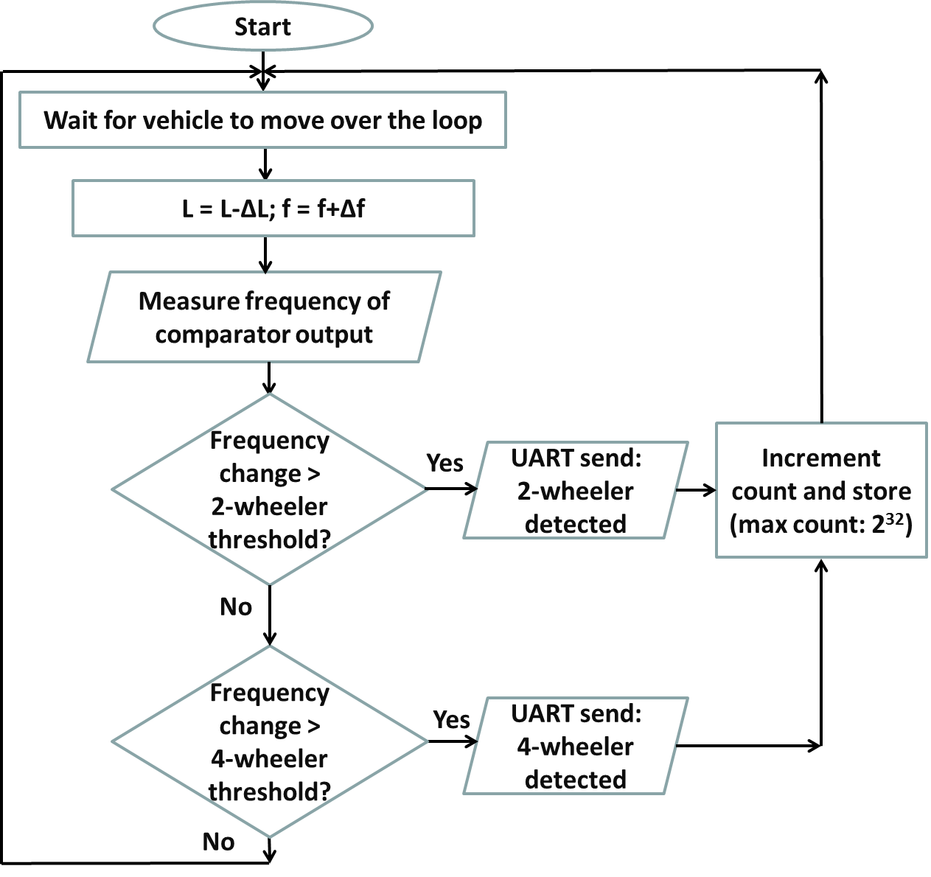
Vehicle Detection and Monitoring using Magnetic Field Sensors
Flowchart for Induction Loop system

Slide 6


Vehicle Detection and Monitoring using Magnetic Field Sensors
Technical Specifications of Induction Loop detector
Induction Loop
    #12 AWG wire
    6 ft x 6 ft square loop
    Length of lead-in cable = 2m
    Inductance: 100µH
    MC33274 Quad Op-Amp IC used to build oscillator (50KHz) and comparator (V_{cc} = 5V)
    Microcontroller: ATmega2560 Arduino Board
        8-Bit, AVR enhanced RISC architecture
        256KBytes of In-System Self-Programmable Flash
        4Kbytes EEPROM
        8Kbytes Internal SRAM

Slide 7
Vehicle Detection and Monitoring using Magnetic Field Sensors
Circuit Diagram of Colpitt’s Oscillator and comparator
To μC

Slide 8
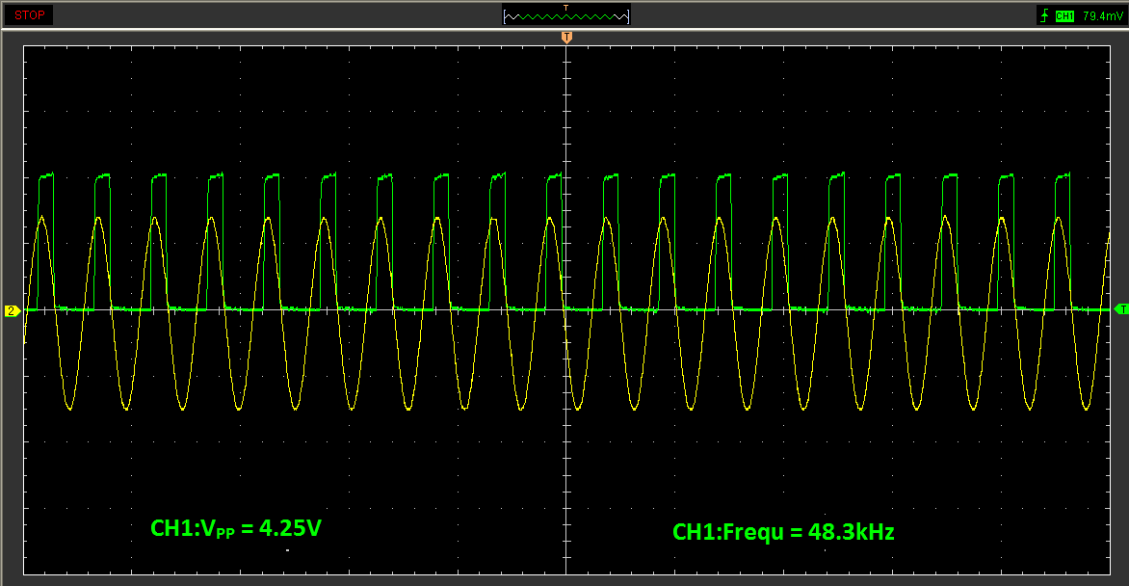
Vehicle Detection and Monitoring using Magnetic Field Sensors
Typical oscillator and comparator output

Slide 9
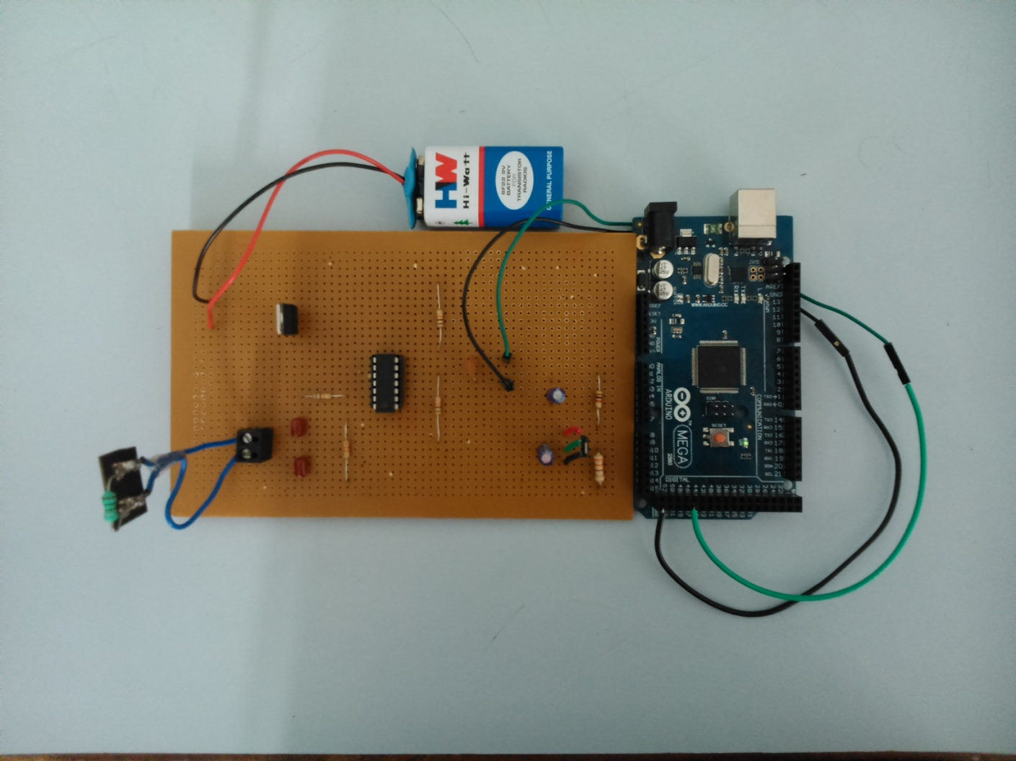
Vehicle Detection and Monitoring using Magnetic Field Sensors
Snapshot of Induction Loop detector components

Slide 10
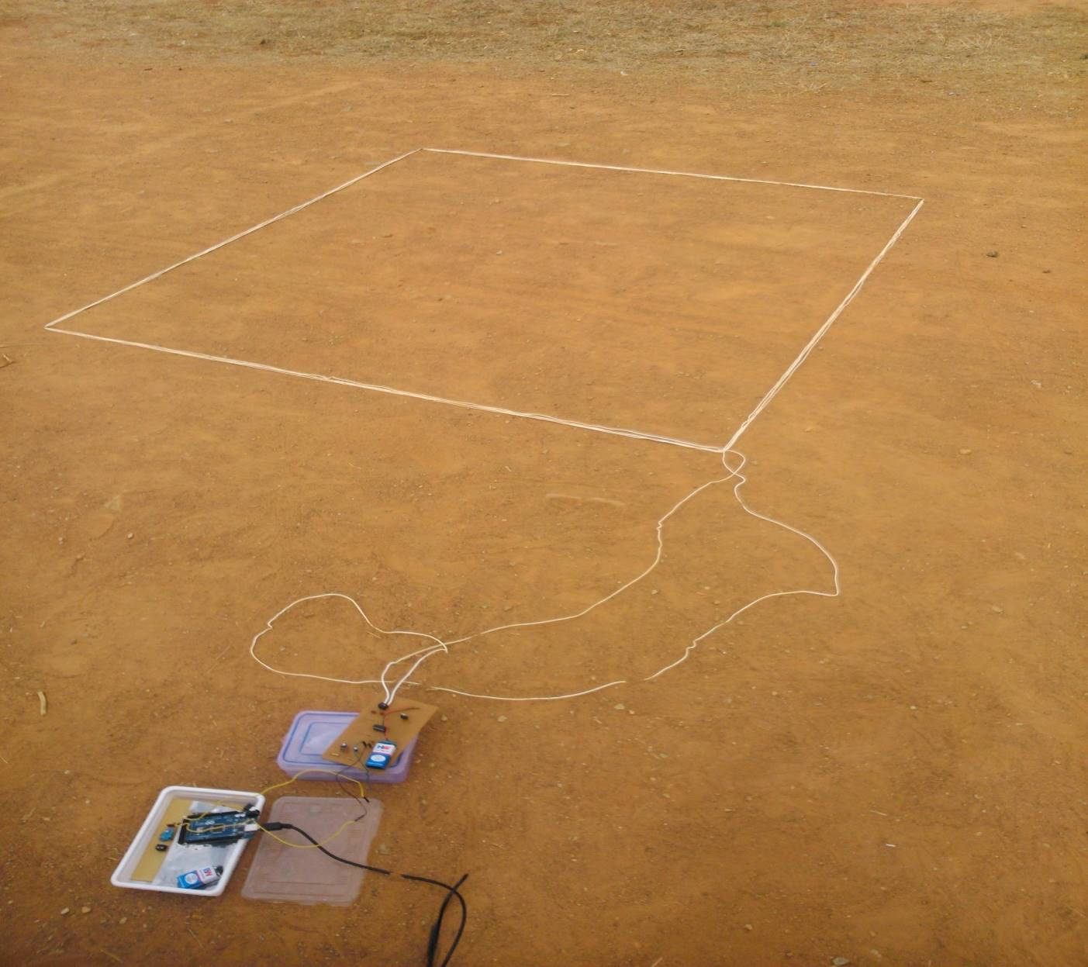
Vehicle Detection and Monitoring using Magnetic Field Sensors
Snapshot of Induction Loop detector system

Slide 11
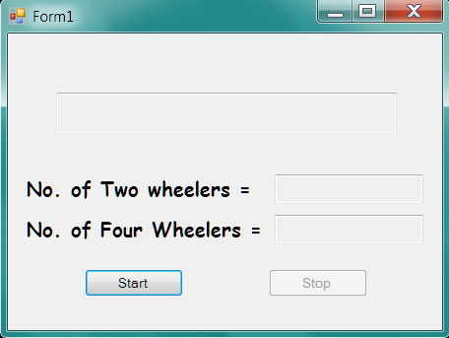
Vehicle Detection and Monitoring using Magnetic Field Sensors
Snapshot of GUI for Induction Loop detector

Slide 12
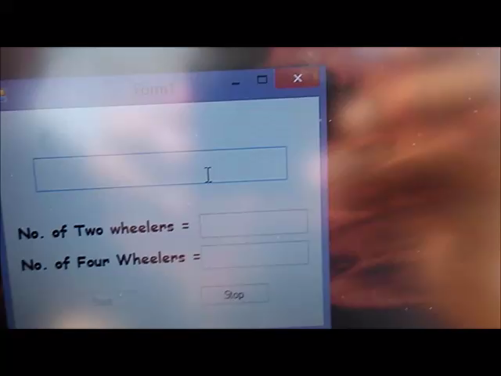
Vehicle Detection and Monitoring using Magnetic Field Sensors
Field test for Induction Loop Detector system

Slide 13
Vehicle Detection and Monitoring using Magnetic Field Sensors
Block Diagram of AMR sensor Vehicle Detection System
Slave Module 1
Master Module
Transceiver
Microcontroller
(Jennic)
AMR sensor
Microcontroller
(Jennic)
Transceiver
Slave Module 2
Computer
AMR sensor
Microcontroller
(Jennic)
Database
GUI
Transceiver

Slide 14
Vehicle Detection and Monitoring using Magnetic Field Sensors
Flowchart for Slave Module
Start
Calibrate Sensor
Sensor output converted to digital value by ADC
Read ADC output
Is ADC value > detection threshold?
Yes
Radio Transmission: Vehicle detected
No

Slide 15
Vehicle Detection and Monitoring using Magnetic Field Sensors
Flowchart for Master Module
Start
Wait for Radio packet arrival from slaves 1 & 2
Radio packet pair Received?
No
Yes
UART send: Vehicle detected
Increment count and store
(max count: 2³²)
Calculate speed = dist/(t₂ – t₁)

Slide 16
Vehicle Detection and Monitoring using Magnetic Field Sensors
Technical Specifications of AMR sensor Vehicle Detection System
AMR sensor
  Supply voltage: 3 - 5V
  Sensitivity: 16 (mV/V)/(kA/m)
  Total power dissipation: 130mW
    Microcontroller: Jennic JN5148-001
      Low power 32-bit RISC CPU, 4 to 32MHz clock speed
  128kB ROM & 128kB RAM for boot loaded program code & data
  4-input 12-bit ADC, 2 12-bit DACs, 2 comparators
  2 UARTs

Slide 17
Vehicle Detection and Monitoring using Magnetic Field Sensors
Technical Specifications of AMR sensor Vehicle Detection System
Radio Transceiver
  2.4GHz IEEE802.15.4 compliant
  Typical data rate: 256kbps
  500 & 667kbps High data rate modes
  Receiver sensitivity -95dBm
  Transmit power 2.5dBm

Slide 18
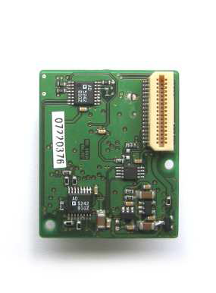
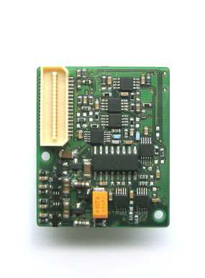
Vehicle Detection and Monitoring using Magnetic Field Sensors
Snapshot of the AMR sensor

Slide 19
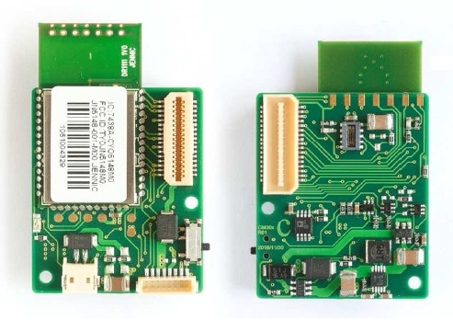
Vehicle Detection and Monitoring using Magnetic Field Sensors
Snapshot of the Wireless microcontroller
(Jennic JN5148)

Slide 20
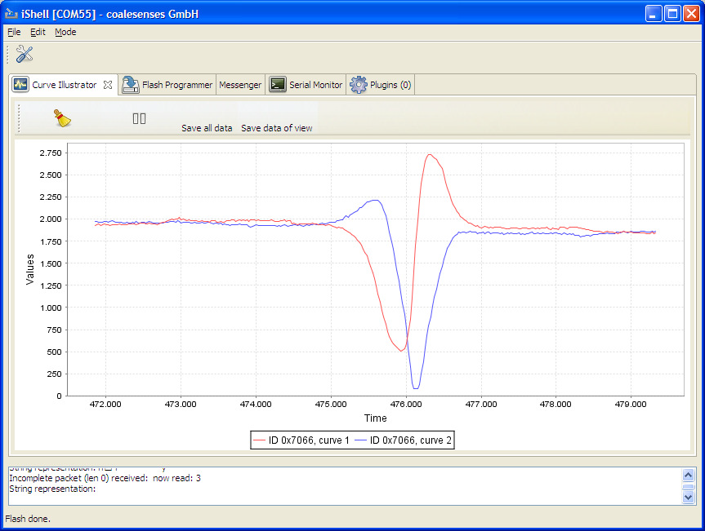
Vehicle Detection and Monitoring using Magnetic Field Sensors
Typical AMR sensor output

Slide 21

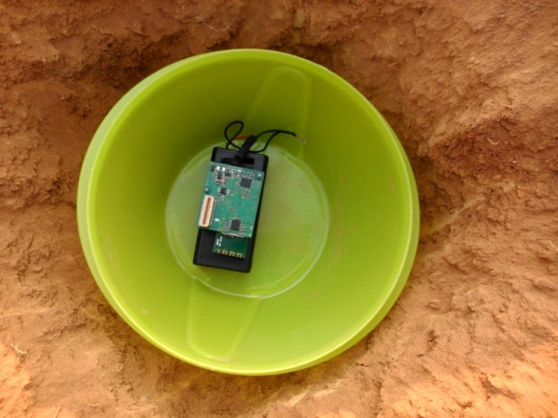
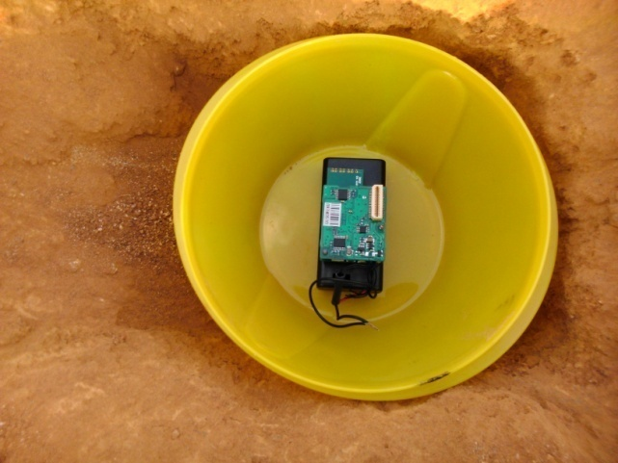
Vehicle Detection and Monitoring using Magnetic Field Sensors
Snapshot of the experimental setup used for speed calculation in case of AMR sensor Vehicle Detection System

Slide 22
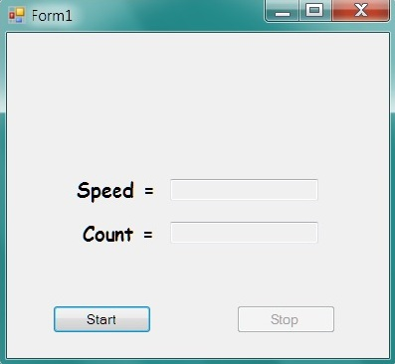
Vehicle Detection and Monitoring using Magnetic Field Sensors
Snapshot of GUI for AMR sensor Vehicle Detection System

Slide 23

Vehicle Detection and Monitoring using Magnetic Field Sensors
Field test for AMR sensor vehicle detection system

Slide 24
Vehicle Detection and Monitoring using Magnetic Field Sensors
Database format for Induction Loop Detector
Date | Two wheeler count | Four Wheeler count | Total count
30/04/2014 | 9 | 9 | 18
01/05/2014 | 5 | 6 | 11
02/05/2014 | 3 | 2 | 5

Slide 25
Vehicle Detection and Monitoring using Magnetic Field Sensors
Database format for AMR sensor Vehicle Detection System
Date | Vehicle count | Avg. speed (kmph)
03/05/2014 | 8 | 22.92
04/05/2014 | 8 | 24.20

Slide 26
Vehicle Detection and Monitoring using Magnetic Field Sensors
Data used to decide the dimension of Induction Loop
Dimensions | No. of turns | Center Frequency | Frequency drift
1.5ft x 1.5ft | 10 | 48.3 kHz | 500 Hz
6ft x 6ft | 2 | 80 kHz (Unstable) | Unreliable
6ft x 6ft | 3 | 51 kHz | 300 Hz
6ft x 6ft | 4 | 41 kHz | 1000 Hz
6ft x 6ft | 5 | 32.5 kHz | 750 Hz
*For four wheelers at 20 kmph

Slide 27
Vehicle Detection and Monitoring using Magnetic Field Sensors
Results for Induction Loop Detector
Type of Vehicle | Speed (kmph) | Frequency drift (Hz) | Avg. frequency drift (Hz)
Two wheeler | 10 | 55 | 55.37
 |  | 52
 |  | 56
 |  | 52
 |  | 64
 |  | 50
 |  | 64
 |  | 50
 | 20 | 50 | 45.42
 |  | 54
 |  | 52
 |  | 42
 |  | 30
 |  | 54
 |  | 36

Slide 28
Vehicle Detection and Monitoring using Magnetic Field Sensors
Results for Induction Loop Detector
Type of Vehicle | Speed (kmph) | Frequency drift (Hz) | Avg. frequency drift (Hz)
Two wheeler | 30 | 48 | 36.25
 |  | 32
 |  | 46
 |  | 24
 |  | 42
 |  | 50
 |  | 22
 |  | 26
 | 40 | 24 | 34.14
 |  | 44
 |  | 36
 |  | 36
 |  | 28
 |  | 26
 |  | 45

Slide 29
Vehicle Detection and Monitoring using Magnetic Field Sensors
Results for Induction Loop Detector
Type of Vehicle | Speed (kmph) | Frequency drift (Hz) | Avg. frequency drift (Hz)
Four wheeler | 10 | 1100 | 1010.8
 |  | 896
 |  | 880
 |  | 962
 |  | 872
 |  | 1106
 |  | 1136
 |  | 990
 |  | 1068
 |  | 1098
 | 20 | 958 | 1006.2
 |  | 1262
 |  | 764
 |  | 806
 |  | 1406
 |  | 900
 |  | 856
 |  | 1010
 |  | 960

Slide 30
Vehicle Detection and Monitoring using Magnetic Field Sensors
Results for Induction Loop Detector
Type of Vehicle | Speed (kmph) | Frequency drift (Hz) | Avg. frequency drift (Hz)
Four wheeler | 30 | 1200 | 1000.2
 |  | 924
 |  | 986
 |  | 1212
 |  | 688
 |  | 952
 |  | 982
 |  | 872
 |  | 940
 |  | 1246
 | 40 | 916 | 937.8
 |  | 746
 |  | 1056
 |  | 1014
 |  | 936
 |  | 960
 |  | 1020
 |  | 899
 |  | 943

Slide 31
Vehicle Detection and Monitoring using Magnetic Field Sensors
Results for AMR sensor vehicle detection system
Type of Vehicle | Actual Speed (kmph) | Detected speed (kmph)
Two Wheelers | 10 | 8.98
 | 10 | 7.64
 | 20 | 18.00
 | 20 | 21.56
 | 30 | 26.54
 | 30 | 28.87
 | 40 | 35.64
 | 40 | 36.11
Four Wheelers | 10 | 10.58
 | 10 | 12.00
 | 20 | 18.23
 | 20 | 20.57
 | 30 | 27.91
 | 30 | 30.35
 | 40 | 37.22
 | 40 | 36.78

Slide 32
Vehicle Detection and Monitoring using Magnetic Field Sensors
Future Enhancements
Induction Loop vehicle detection system
  Two loops can be used to determine the speed of the vehicles.
    AMR vehicle detection system
      Sensors with higher sampling rate can be used to classify vehicles based on their magnetic signature.
      Auxiliary sensors such as video processing systems and infrared sensors can be used in conjunction with the induction loop and AMR sensor systems to eliminate false counts and increase the accuracy of the traffic parameters acquired.

Slide 33
Vehicle Detection and Monitoring using Magnetic Field Sensors
Conclusions
Advantages of Induction loop detector system: initial installation costs are much lower; can also detect stopped vehicles.
However, AMR sensors are more sensitive to the presence of magnetic materials.
They are easy to reinstall and maintenance costs are low.
Smaller in size compared to inductive loops which require a minimum area of around 36 sq. ft.
They are more energy efficient, use state-of-the-art low-power sensing, amplification, and communication technologies.
Thus magnetic sensor systems are more efficient and reliable than induction loops.

Slide 34
Vehicle Detection and Monitoring using Magnetic Field Sensors
References
[1] Ravneet Bajwa, Ram Rajagopal, Pravin Varaiya and Robert Kavaler. In-Pavement Wireless Sensor Network for Vehicle Classification.
[2] Sing Yiu Cheung, Sinem Coleri Ergen and Pravin Varaiya. Traffic Surveillance with Wireless Magnetic Sensors.
[3] Farshad Ahdi, Mehdi Kalantari Khandani, Masoud Hamedi, Ali Haghani.
Traffic data collection and anonymous vehicle detection using wireless sensor networks.
[4] Traffic Detector Handbook: Third Edition—Volume I. Publication No. FHWA-HRT-06-108.
[5] D. Cebon. Handbook of Vehicle-Road Interaction.
Swets and Zeitlinger Publishers, 1999.

Slide 35
Vehicle Detection and Monitoring using Magnetic Field Sensors
References
[6] Sun C. (2004). An investigation in the use of inductive loop signatures for vehicle classification. California PATH Research Report UCB-ITS-PRR-2002-4.
[7] Zhang, X., Y. Wang, N.L. Nihan (2004). Monitoring a freeway network in real-time using single-loop detectors: System design and implementation, 83rd TRB Annual Meeting, Washington, D.C.
[8] Ding, J (2003). Vehicle detection by sensor network nodes. MS thesis, Department of Electrical Engineering and Computer Science, University of California, Berkeley, CA.
[9] Oh, S., S.G. Ritchie, C (2002). Oh. Real time traffic measurement from single loop inductive signatures, 81st TRB Annual Meeting, Washington, D.C.

